Slide 1
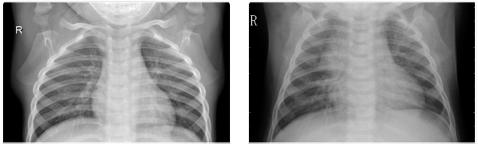
Pneumonia Detection from Chest X-Ray Images
Hemanth Kumar 19BM6JP27 • Karthikeya Racharla 19BM6JP32 • Subramania Bharathi 19BM6JP36
Presented at Final End Term Project Evaluation
for
BM69006 Data Science Laboratory 2020
Indian Institute of Technology Kharagpur
June 14, 2020

Slide 2
INTRODUCTION
According to the World Health Organization (WHO), pneumonia kills about 2 million children under 5 years old every year and is consistently estimated as the single leading cause of childhood mortality (Rudan et al., 2008), killing more children than HIV/AIDS, Malaria, and Measles combined.
Chest X-rays - Currently the best available method for diagnosing pneumonia as stated by WHO (2001). However, detecting pneumonia is a challenging task that relies on the availability of expert radiologists.

Slide 3
MOTIVATION
Bacterial Pneumonia requires urgent referral for immediate antibiotic treatment, while Viral Pneumonia is treated with supportive care
Therefore, accurate and timely diagnosis is imperative
However, rapid radiologic interpretation of images is not always available, particularly in the low-resource settings where childhood pneumonia has the highest incidence and highest rates of mortality

Slide 4
PROBLEM STATEMENT
Build an AI model which can automatically detect Pneumonia from Chest X-ray images
Sub-problems:
1) Pneumonia vs. Normal Cases Classification with Chest X-ray
2) Bacterial vs. Viral Cases Classification with Chest X-ray

Slide 5
IMPORTANT METRICS
Immediate treatment for someone with pneumonia is utmost important, so everyone with pneumonia has to be found out correctly with the model, i.e., in evaluation terms of Machine Learning:
Recall has to be high for Pneumonia vs Normal cases
Once some one is diagnosed with Pneumonia, we have to identify whether it is a viral pneumonia case or bacterial pneumonia, as the patient has to be treated accordingly because mistreatment as a viral case could be fatal. Moreover, the treatments for both are different.
In this case, Precision is very important

Slide 6
SIGNIFICANCE OF THE PROJECT
Potential for generalized high-impact application in biomedical imaging
To quote an example, in Africa’s 57 nations, a gap of 2.3 million doctors and nurses exists. For these populations, accurate and fast diagnosis means everything. It can guarantee timely access to treatment and save much needed time and money for those already experiencing poverty
The techniques used in the projects could be extended for detecting other lung diseases where X-ray based detection techniques are currently used
Ideal example for the same is the current ongoing research and diagnosis on detecting COVID-19 with Chest X-ray images

Slide 7
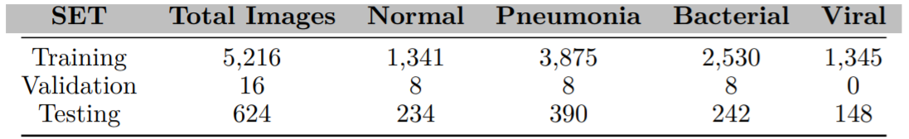
ABOUT THE DATASET
There are a total of 5,856 X-Ray Grey-Scale images (JPEG) and 2 categories, namely Pneumonial vs. Normal images.
These pediatric chest X-rays of pneumonial patients is further distinguished into viral and bacterial pneumonia to facilitate rapid referrals for children needing urgent intervention.
Class Imbalance

Slide 8
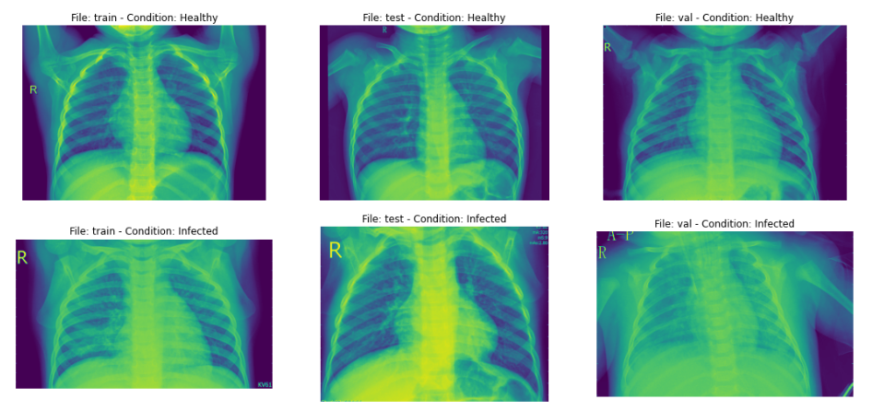
PNEUMONIA VS NORMAL X-RAY IMAGES

Slide 9
DATA AUGMENTATION
Technique to artificially create new training data from existing training data
Implementation: ImageDataGenerator class from Keras
Transformations used include:
Zoom
Horizontal shift, Vertical shift
Horizontal flip, Rotation and shear

Slide 10
PREVIOUS WORK AND RESULTS
Kermany et. al (2018) have developed an Image-based deep learning classifies macular degeneration and diabetic retinopathy using retinal optical coherence tomography images, that is generalized to have potential for applications in biomedical image interpretation and medical decision making
[Pneumonia vs. Normal] They achieved an accuracy 92.8%, with sensitivity 93.2%, specificity 90.1% and Precision 98.45%
[Bacterial vs. Viral Pneumonia] resulted in test accuracy 90.7%, with sensitivity 88.6%, specificity 90.9% and Precision 48.112%
Reference: Kermany et. al (Cell Journal 2018)

Slide 11
OUR CONTRIBUTION / MODEL USED
Training Convolution Neural Network from scratch
Transfer learning model
InceptionV3
DenseNet
ResNet50
VGG16
Note: Results of these models will be compared with results obtained in prior benchmark studies

Slide 12
CNN ARCHITECTURE
INPUT FEATURE EXTRACTION CLASSIFICATION OUTPUT
Feature extraction - The feature extraction component of a convolutional neural network is what distinguishes CNNs from other multilayered neural networks. It typically comprises of repeating sets of these sequential steps
CONVOLUTION LAYER POOLING LAYER NON-LINEAR ACTIVATION UNIT

Slide 13
CNN ARCHITECTURE: DEBRIEF
Block-1
Block-2
Block-3
Conv2D
Conv2D
Max-Pooling
SeparableConv2D
SeparableConv2D
BatchNormalization
Max-Pooling
SeparableConv2D
SeparableConv2D
BatchNormalization
Max-Pooling
Block-6
Block-5
Block-4
Flatten Dense Layer DropOut Dense Layer DropOut Output Layer
SeparableConv2D
SeparableConv2D
BatchNormalization
Max-Pooling
DropOut
SeparableConv2D
SeparableConv2D
BatchNormalization
Max-Pooling
DropOut

Slide 14
CONVOLUTION LAYERS
POOLING LAYERS
Action
Apply filters to extract features
Filters are composed of small kernels, learned
One bias per filter
Apply activation function on every value of feature map
Parameters
Number of kernels
Size of kernels
Activation function
Stride
Padding
Regularization type and value
Action
Reduce dimensionality
Extra maximum of average of a region
Sliding window approach
Parameters
Stride
Size of window

Slide 15

TRANSFER LEARNING
Intuition: What has been learned in one setting is exploited to improve generalization in another setting
Why Transfer Learning?
CNNs are data-hungry: require significant amounts of data and Resources to train
ImageNet ILSVRC Model was trained on 1.2 million images over the period of 2–3 weeks across multiple GPUs
We can make use of the features learned in those pre trained model
Advantages of transfer learning
Reduces the training time and data needed to achieve a custom task
Very popular in Computer Vision; often produces robust models with improvement in Metrics
How to use it?
It takes a CNN that has been pre-trained (typically ImageNet), removes the last fully-connected layer and replaces it with our custom fully-connected layer, treating the original CNN as a feature extractor for the new dataset. Once replaced, the last fully-connected layer we train the classifier for the new dataset

Slide 16
MODEL RESULTS

Slide 17
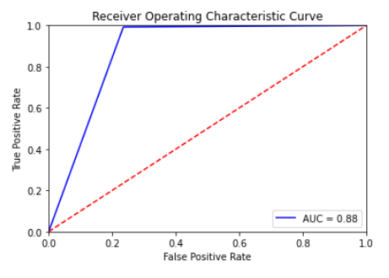
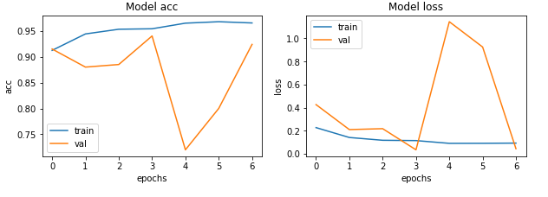
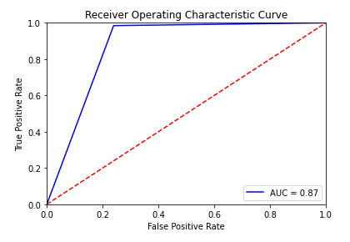
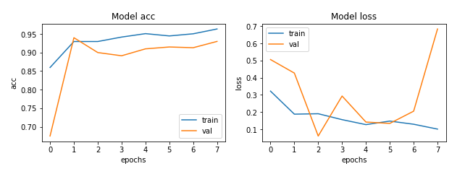
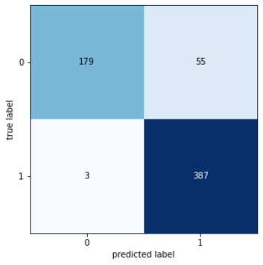
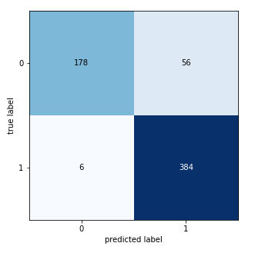
VGG16 MODEL
NORMAL VS PNEUMONIA RESULTS
INCEPTION-V3 MODEL
TEST METRICS
Accuracy: 90.71%
Precision: 87.55%
Recall: 99.23%
F1-score: 93.02%
TEST METRICS
Accuracy: 90.06%
Precision: 87.27%
Recall: 98.46%
F1-score: 92.53%
BENCHMARK RECALL VALUE : 93.2%
BENCHMARK RECALL VALUE : 93.2%
ACHIEVED BETTER THAN BENCHMARK
ACHIEVED BETTER THAN BENCHMARK

Slide 18
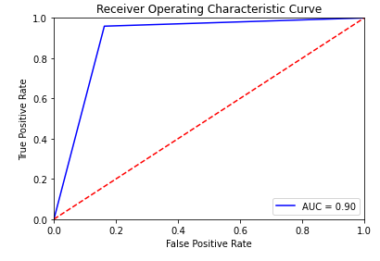
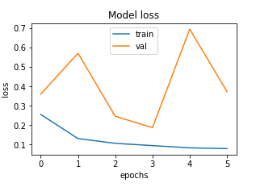
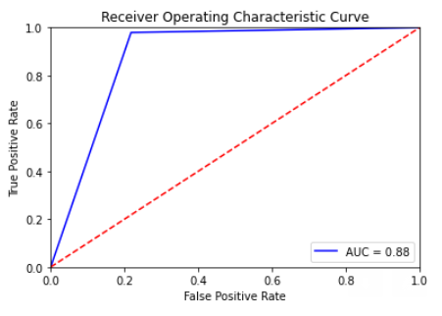
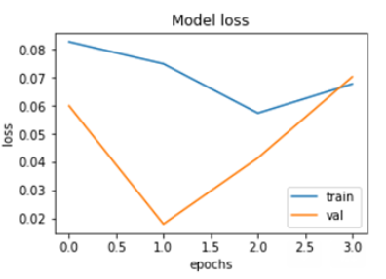
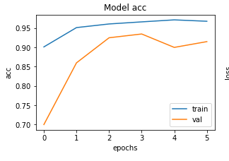
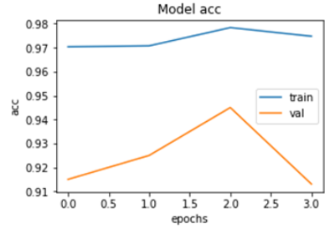
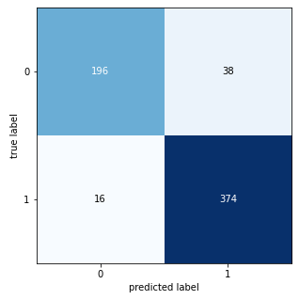
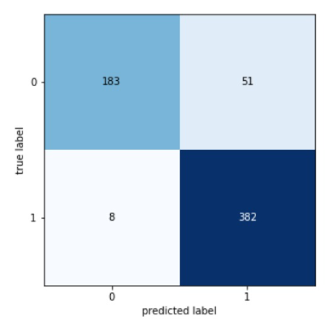
DENSENET MODEL
NORMAL VS PNEUMONIA RESULTS
RESNET50 MODEL
Test metrics
Accuracy: 91.34%
Precision: 90.77%
Recall: 95.89%
F1-score: 93.26%
Test metrics:
Accuracy: 92.95% Precision: 92.95% Recall: 95.64%
F1-score: 94.43%
BENCHMARK RECALL VALUE : 93.2%
BENCHMARK RECALL VALUE : 93.2%
ACHIEVED BETTER THAN BENCHMARK
ACHIEVED BETTER THAN BENCHMARK

Slide 19
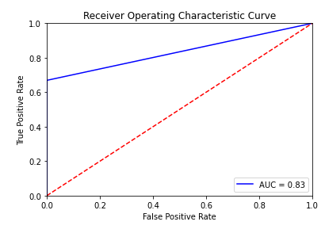
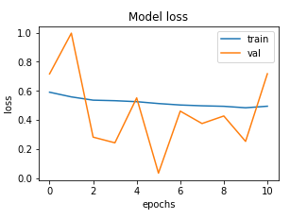
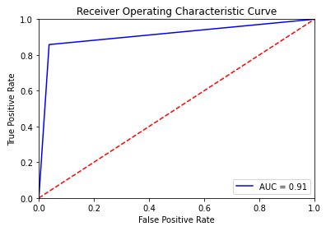
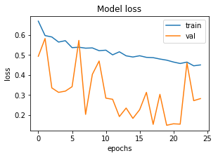
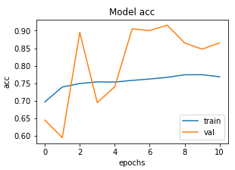
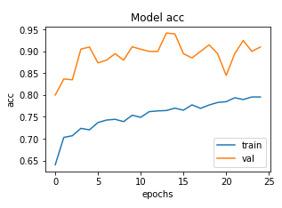
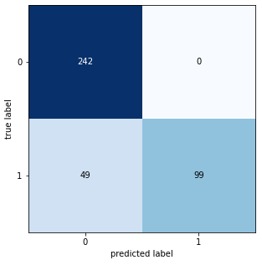
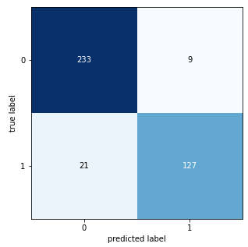
VGG16 MODEL
BACTERIAL VS. VIRAL CLASSIFICATION RESULTS
INCEPTION-V3 MODEL
Test metrics
Accuracy: 87.43%
Precision: 100.0%
Recall: 66.89%
F1-score: 80.16%
TEST METRICS
Accuracy: 90.06%
Precision: 87.27%
Recall: 98.46%
F1-score: 92.53%
BENCHMARK PRECISION,F1: 48.11%, 62.36%
BENCHMARK PRECISION,F1: 48.11%, 62.36%
ACHIEVED BETTER THAN BENCHMARK
ACHIEVED BETTER THAN BENCHMARK

Slide 20
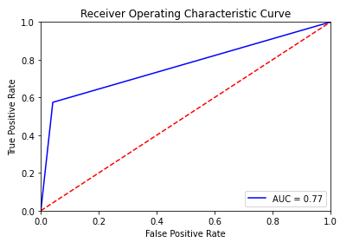
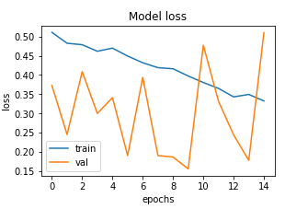
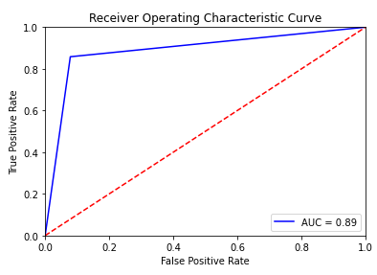
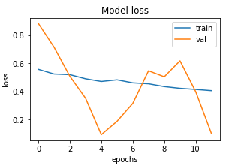
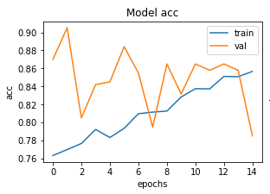
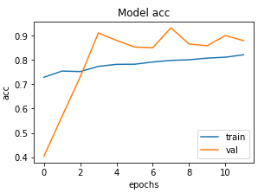
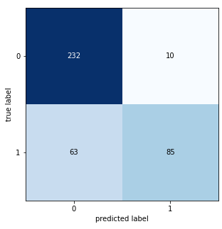
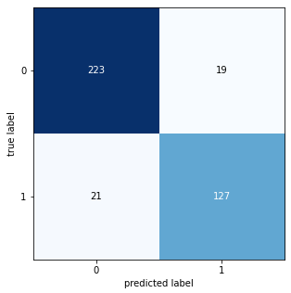
DENSENET MODEL
BACTERIAL VS. VIRAL CLASSIFICATION RESULTS
RESNET50 MODEL
Test metrics:
Accuracy: 81.28%
Precision: 89.47%
Recall: 57.43%
F1-score: 69.96%
Test metrics:
Accuracy: 89.74%
Precision: 86.98%
Recall: 85.81%
F1-score: 86.39%
BENCHMARK PRECISION,F1: 48.11%, 62.36%
BENCHMARK PRECISION,F1: 48.11%, 62.36%
ACHIEVED BETTER THAN BENCHMARK
ACHIEVED BETTER THAN BENCHMARK

Slide 21
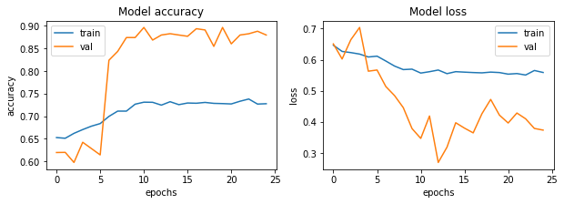
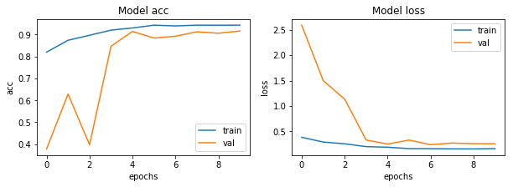
CNN RESULTS
BACTERIAL VS. VIRAL CLASSIFICATION RESULTS
Test metrics:
Accuracy: 88.21%
Precision: 94.74%
Recall: 72.97%
F1-score: 82.4%
NORMAL VS PNEUMONIA RESULTS
Test metrics:
Accuracy: 91.03%
Precision: 89.76%
Recall: 96.66%
F1-score: 93.08%

Slide 22
CONSOLIDATED RESULTS
NORMAL VS PNEUMONIA RESULTS
Models | Precision | Recall | Accuracy | F1 Score | AUC
VGG16 | 87.55 | 99.23 | 90.71 | 93.02 | 88
InceptionV3 | 87.27 | 98.46 | 90.06 | 92.53 | 87
DenseNet | 90.77 | 95.89 | 91.34 | 93.26 | 90
ResNet50 | 92.95 | 95.64 | 92.95 | 94.43 | 92
CNN | 89.76 | 96.66 | 91.03 | 93.08 | 91
BACTERIAL VS. VIRAL CLASSIFICATION RESULTS
Models | Precision | Recall | Accuracy | F1 Score | AUC
VGG16 | 100 | 66.89 | 87.43 | 80.16 | 83
InceptionV3 | 87.27 | 98.46 | 90.06 | 92.53 | 87
DenseNet | 89.47 | 57.43 | 81.282 | 69.958 | 77
ResNet50 | 86.98 | 85.81 | 89.74 | 86.39 | 89
CNN | 94.736 | 72.97 | 88.205 | 82.44 | 85

Slide 23
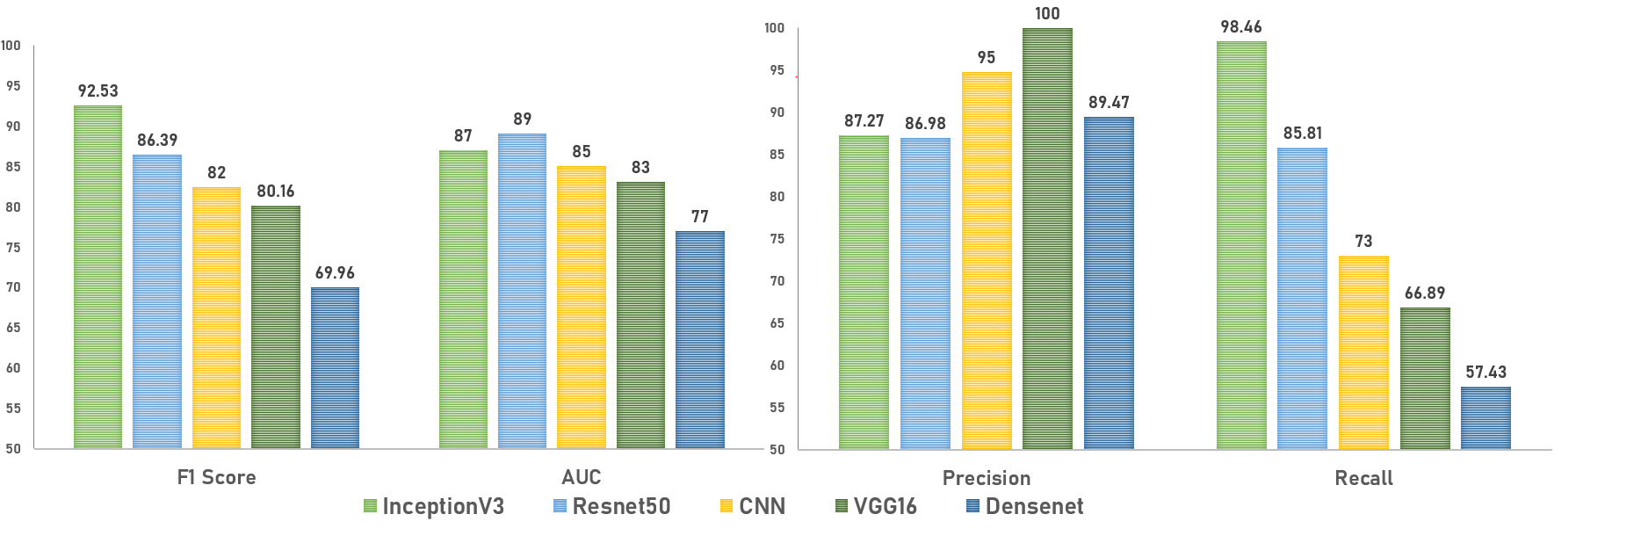
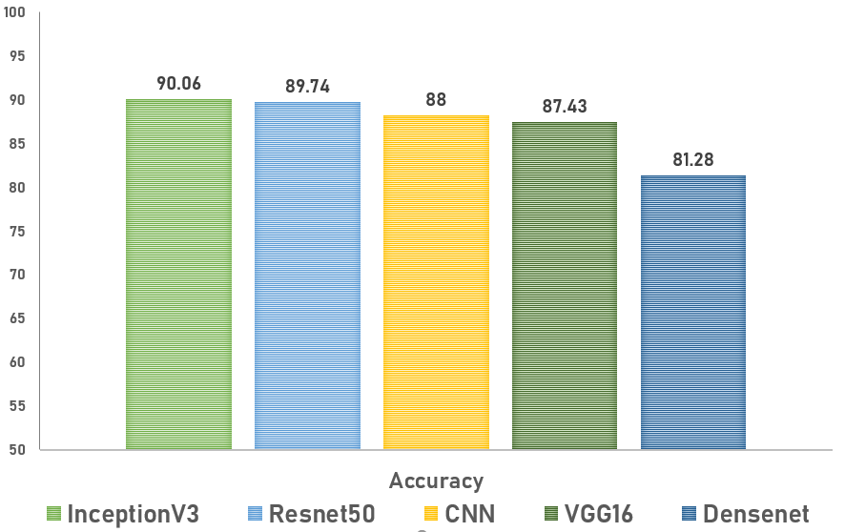
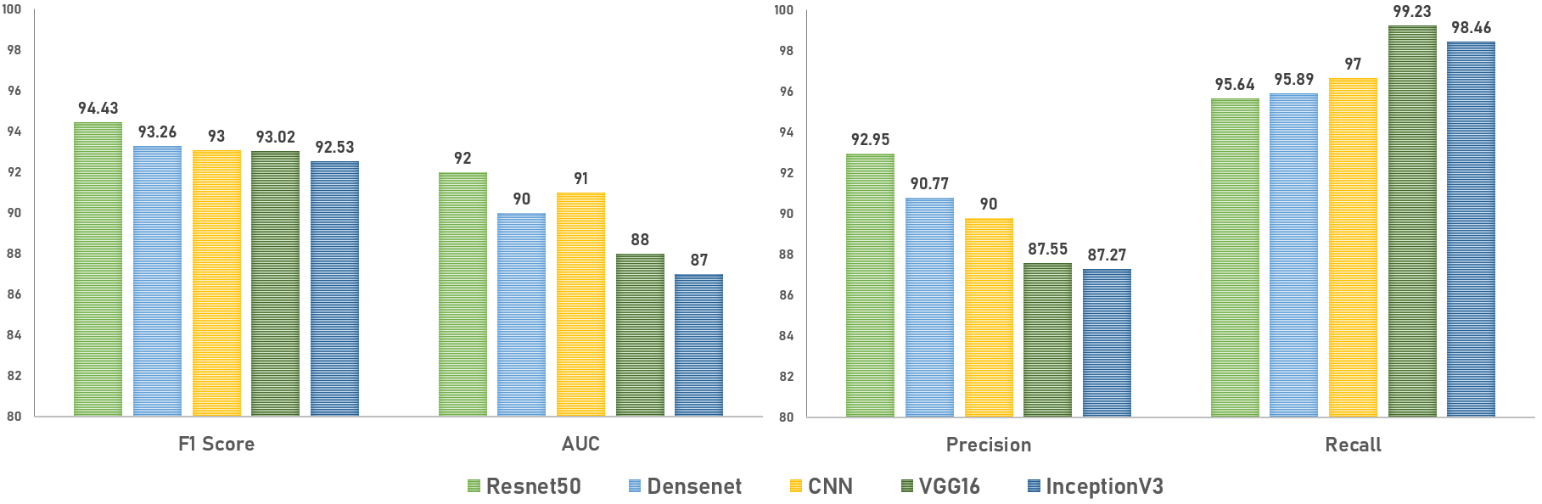
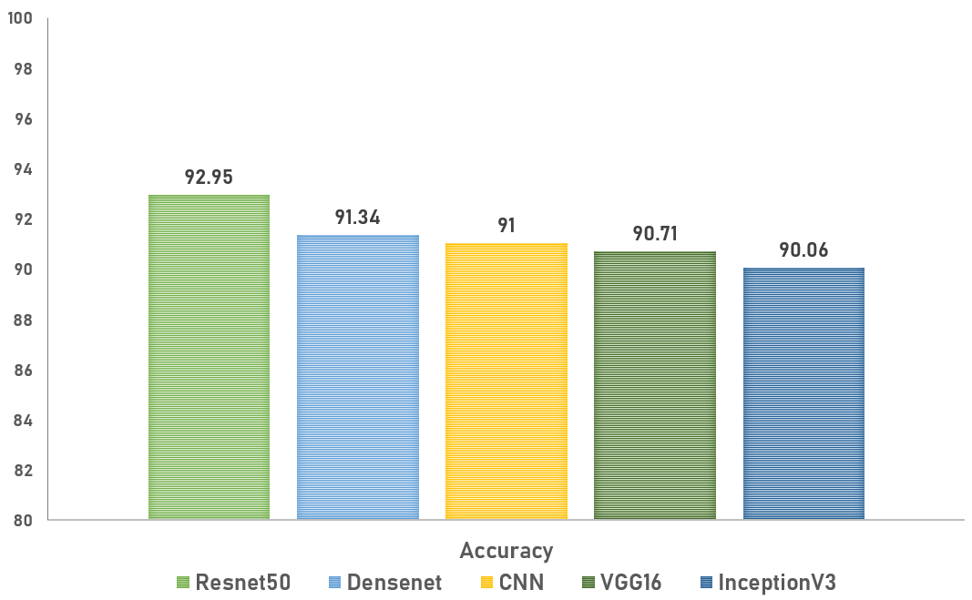
SUMMARY OF RESULTS
BACTERIAL VS. VIRAL CLASSIFICATION RESULTS
NORMAL VS PNEUMONIA RESULTS

Slide 24
CONCLUSION
We can clearly see from the results that our transfer learning models are performing better than our conventional CNN model
For Normal vs Pneumonia case - Our transfer learning model has performed remarkably well and has produced Recall better than the benchmark score (93.2%); VGG16 (Recall: 99.23) being the champion model
For Bacterial vs. Viral case - Our models have produced better F1 scores and Precision than the benchmarks of F1 (62.36%) and Precision(48.11%); INCEPTIONV3 (F1-Score 92.53%) being the champion model
Showcased the power of the transfer learning system to make highly effective classifications (better than benchmarks), even with a very limited training data

Slide 25
FUTURE SCOPE
Long way in improving the health of at-risk children in energy-poor environments
Our study was limited by depth of Data. With increased access to data and training of the model with radiological data from patients and nonpatients in different geography, significant improvements can be made
Future studies could entail use of images from varied manufacturers, so that the system will be universally useful
Ophthalmology, CT Scans —in principle, the techniques we have described here could potentially be extended in a wide range of medical images across multiple disciplines
Perform Occlusion testing to identify areas of greatest importance used by model while assigning a diagnosis

Slide 26

REFERENCES & ACKNOWLEDGEMENTS
Kermany et. al, Michael Goldbaum, Michael Goldbaum, Wenjia Cai, Carolina C.S. Valentim, Huiying Liang, Sally L. Baxter, Alex McKeown. Identifying medical diagnoses and treatable diseases by image-based deep learning. In Cell 172, 1122–1131, 2018
Kang Zhang., MD, PhD, professor of Ophthalmology at Shiley Eye Institute and founding director of the Institute for Genomic Medicine at UC San Diego School of Medicine
Kaggle Dataset Link
Github Code Repository: https://github.com/KarthikeyaR/pneumonia-detection
We are grateful to Prof. Sujoy Bhattacharya for allowing us to pursue such an interesting topic for our course project, guiding us throughout and evaluating the project results

